Slide 1
City Navigator
By: Guided By:
Madhav - GIC1221021 Sandhya Singh, HCL TSS
Ravitej Kaur – GIC1221002
Sangavi - GIC1221003
Varshini - GIC1221001

Slide 2
Index
Introduction
Module
Software Interface
Use Case Diagram
Class Diagram
Sequence Diagram
Project Screenshots
Future Scope

Slide 3
Introduction
Describing a set of technology-based solutions.
Redefines the travelling experience.
Providing details of the places and restaurants for different states.
Provides details for travelling.

Slide 4
Module
Customer

Slide 5
Software Interface
Tool: Spring Tool Suite
Languages: HTML, CSS, Java
Database: MySQL

Slide 6
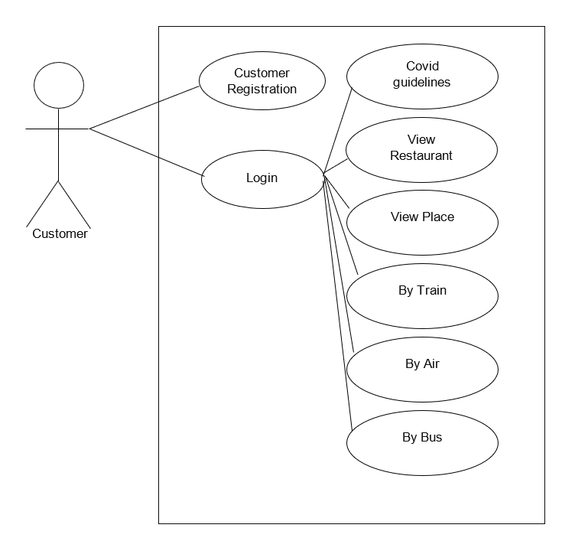
Use Case Diagram

Slide 7
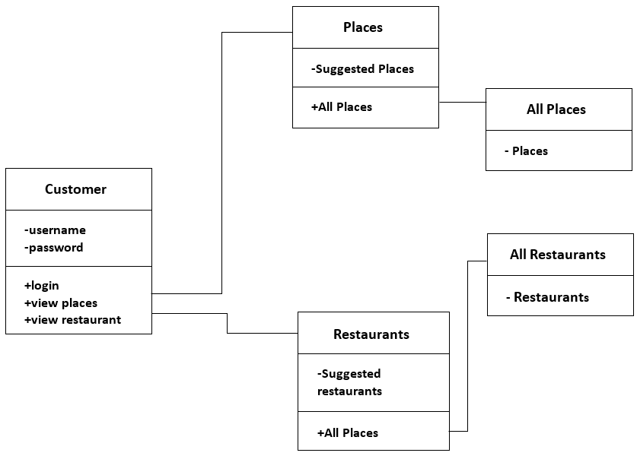
Class Diagram

Slide 8
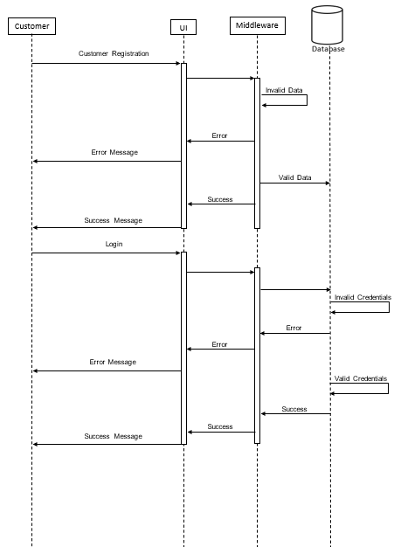
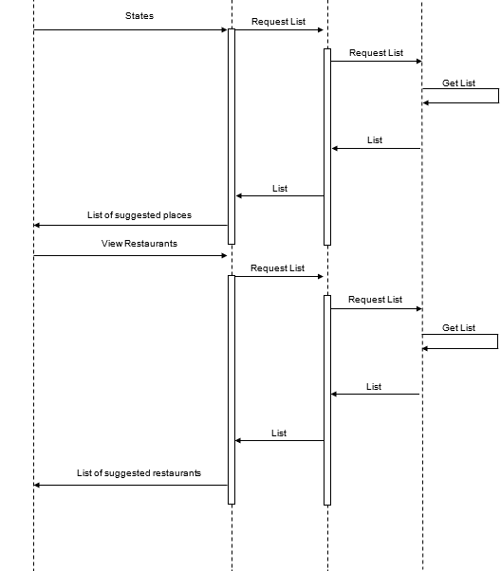
Sequence Diagram

Slide 9
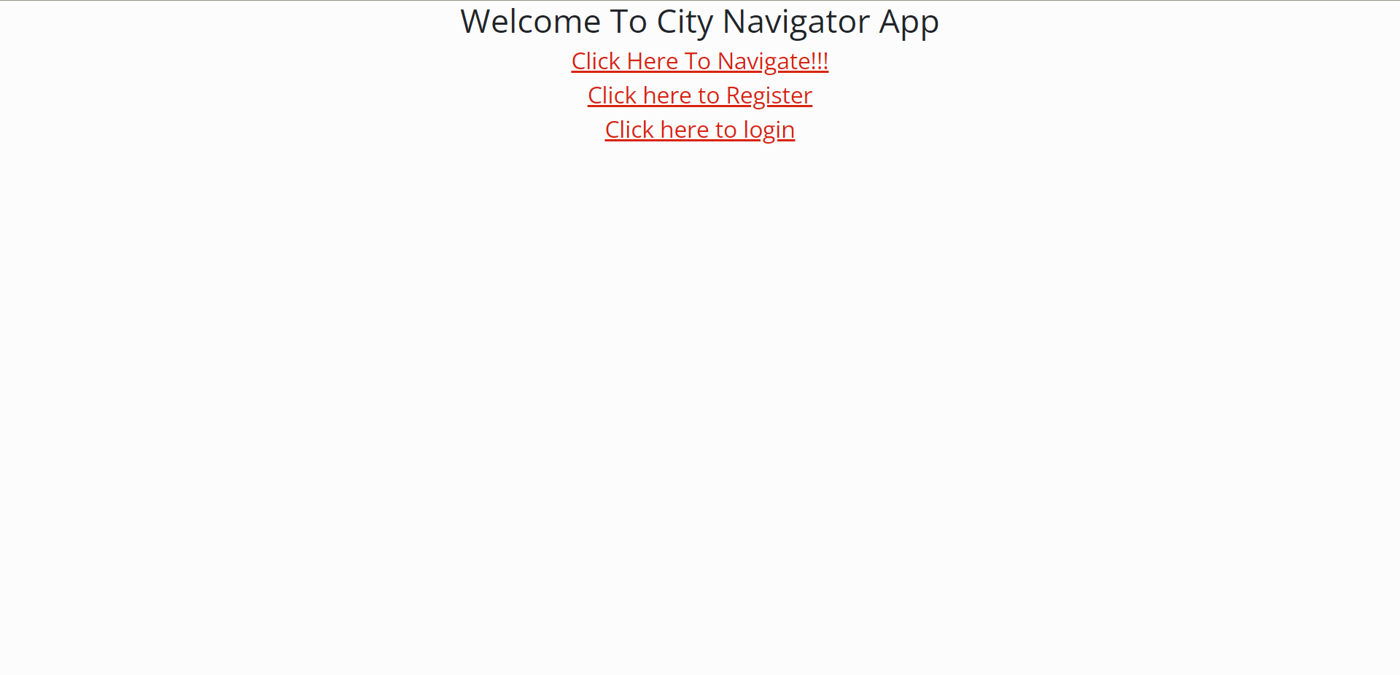
Project Screenshots - Home

Slide 10
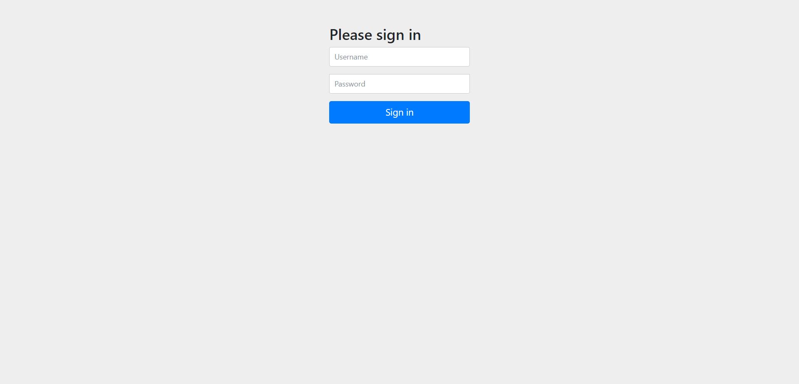
Project Screenshots – Login Page

Slide 11
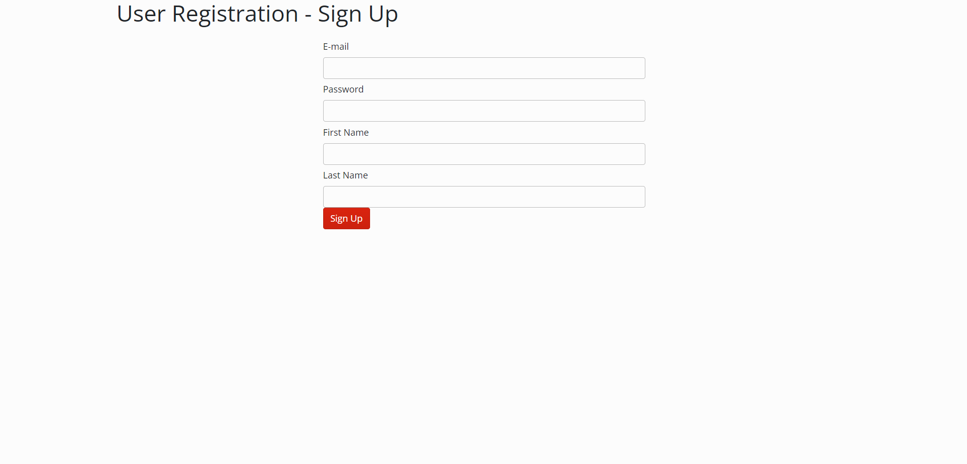
Project Screenshots – Registration Form

Slide 12
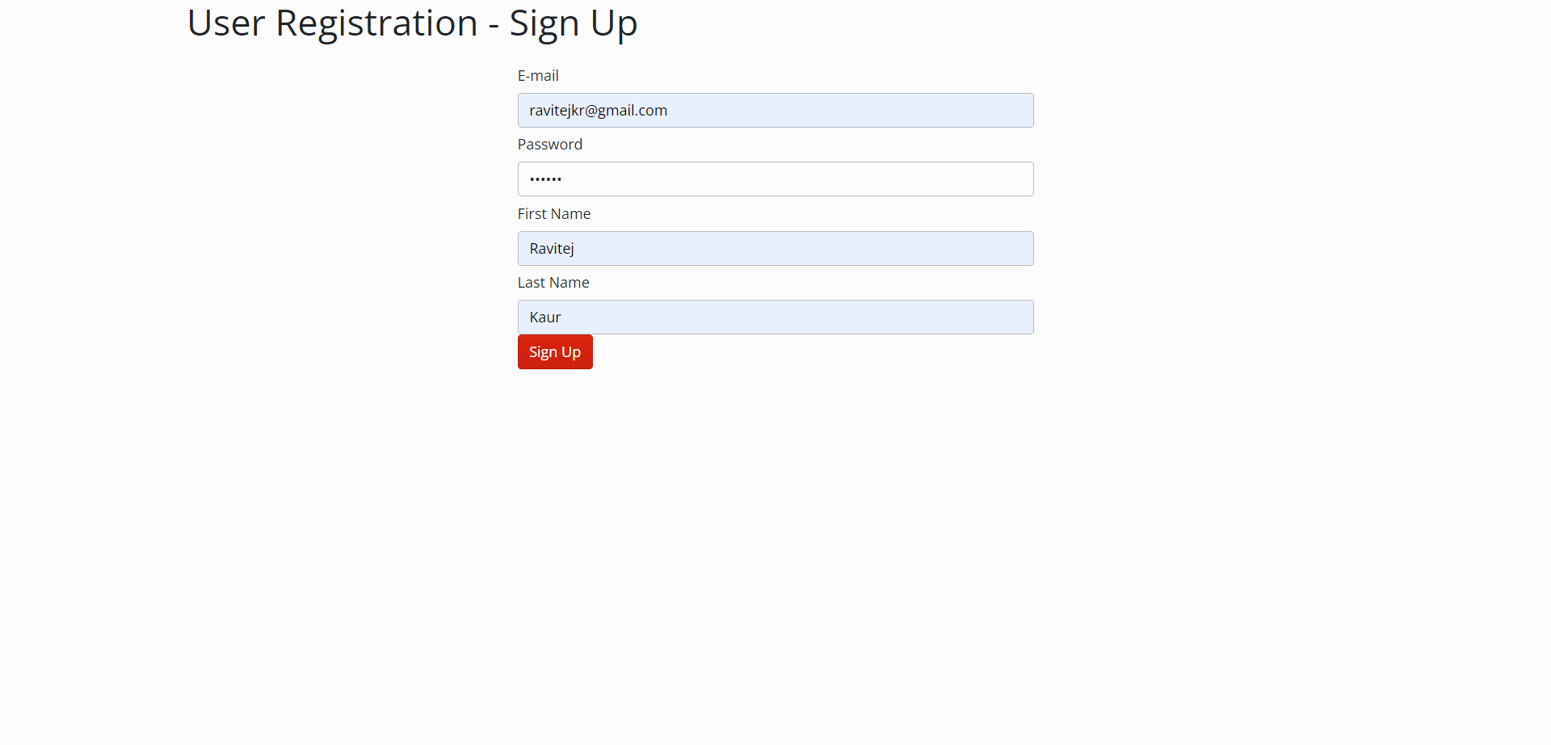
Project Screenshots – Registration Form

Slide 13
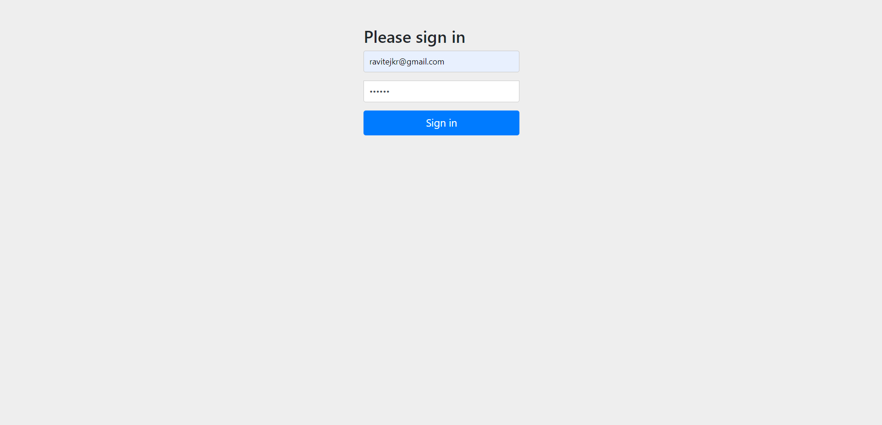
Project Screenshots - Logging

Slide 14
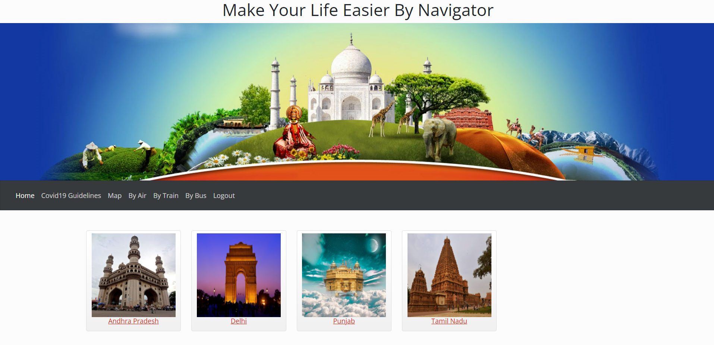
Project Screenshots – Customer Profile

Slide 15
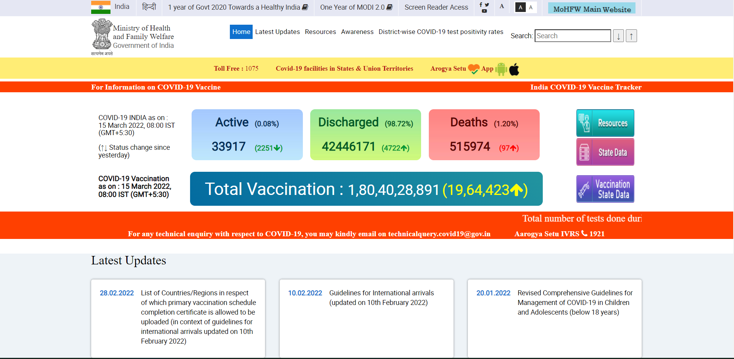
Project Screenshots – Covid 19 Guidelines

Slide 16
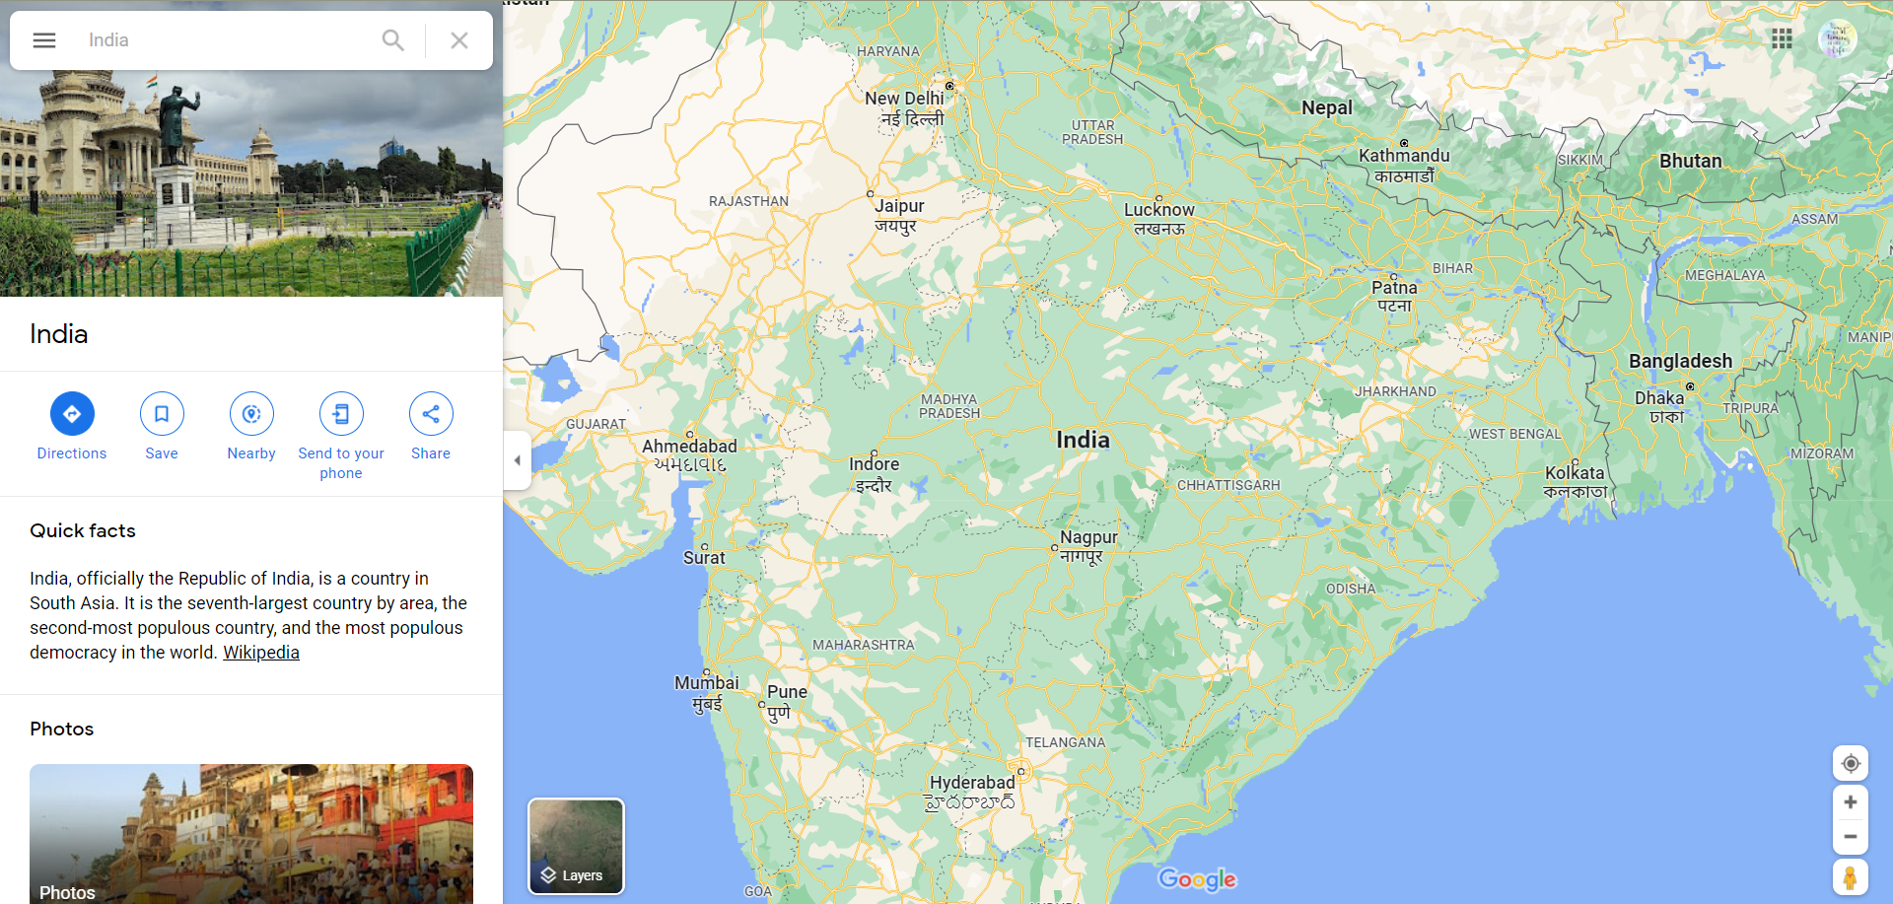
Project Screenshots - Maps

Slide 17
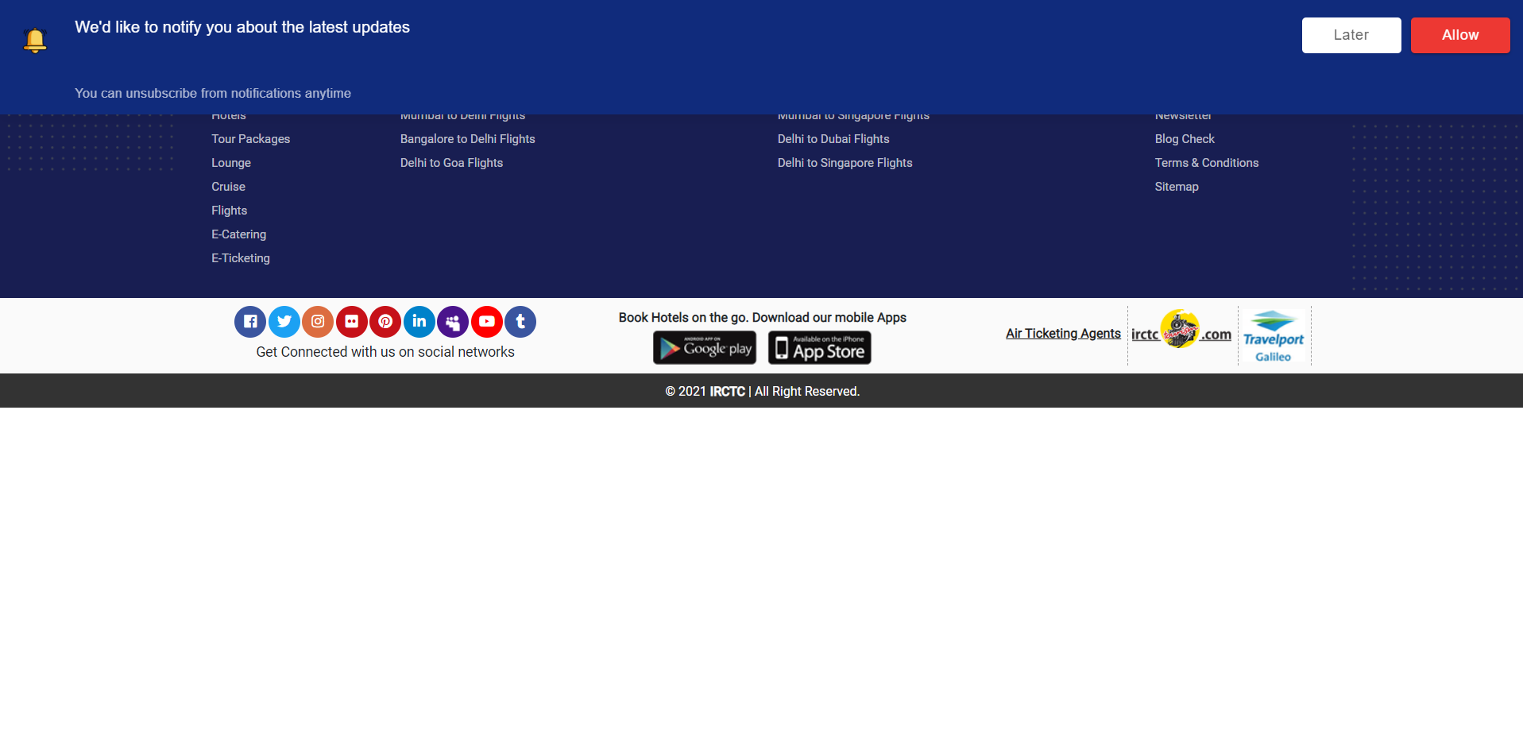
Project Screenshots – By Air

Slide 18
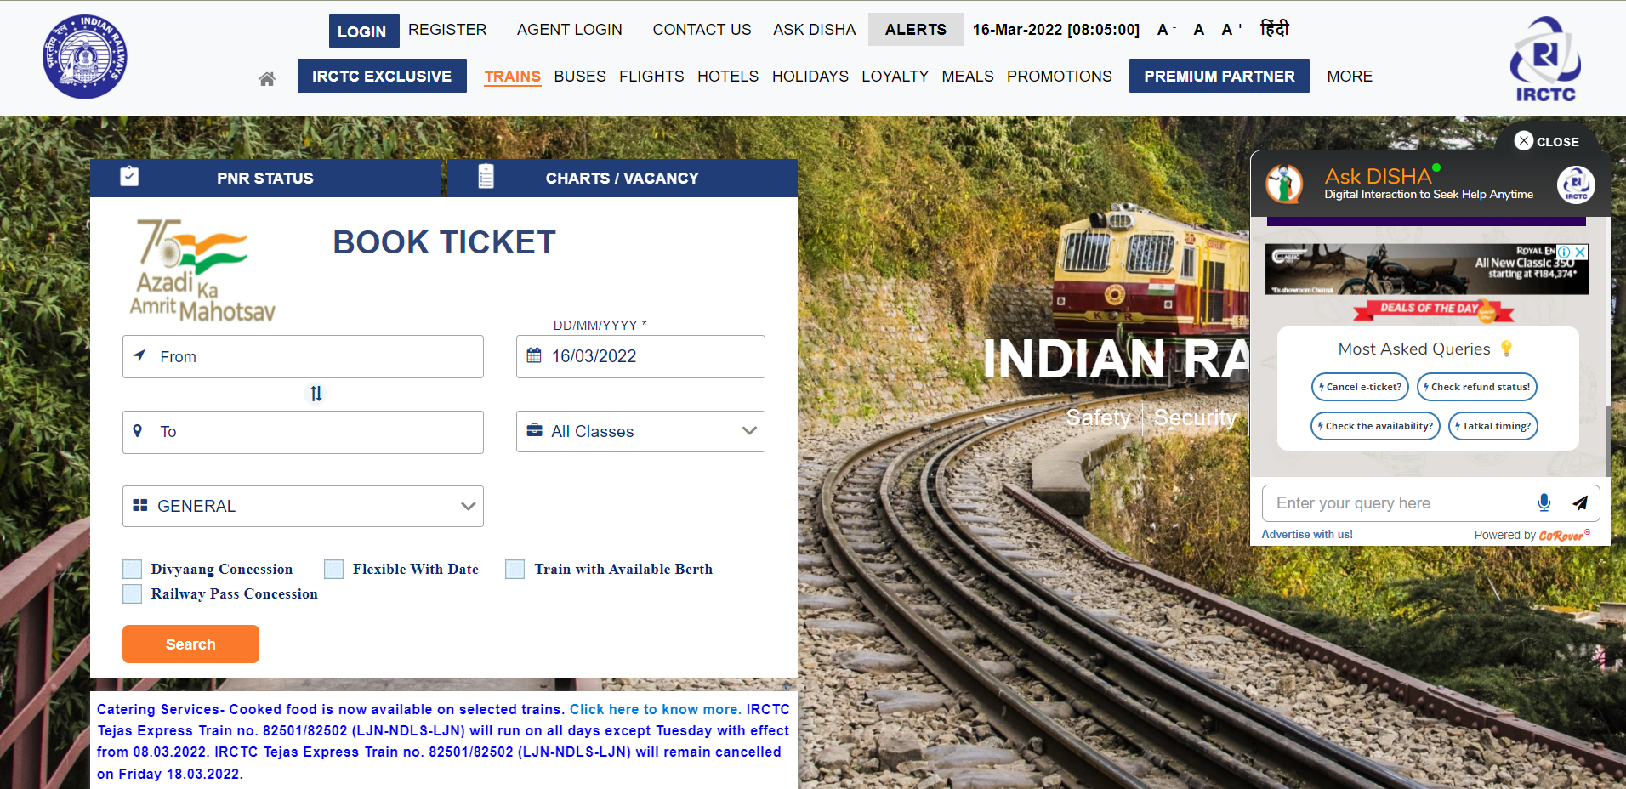
Project Screenshots – By Train

Slide 19
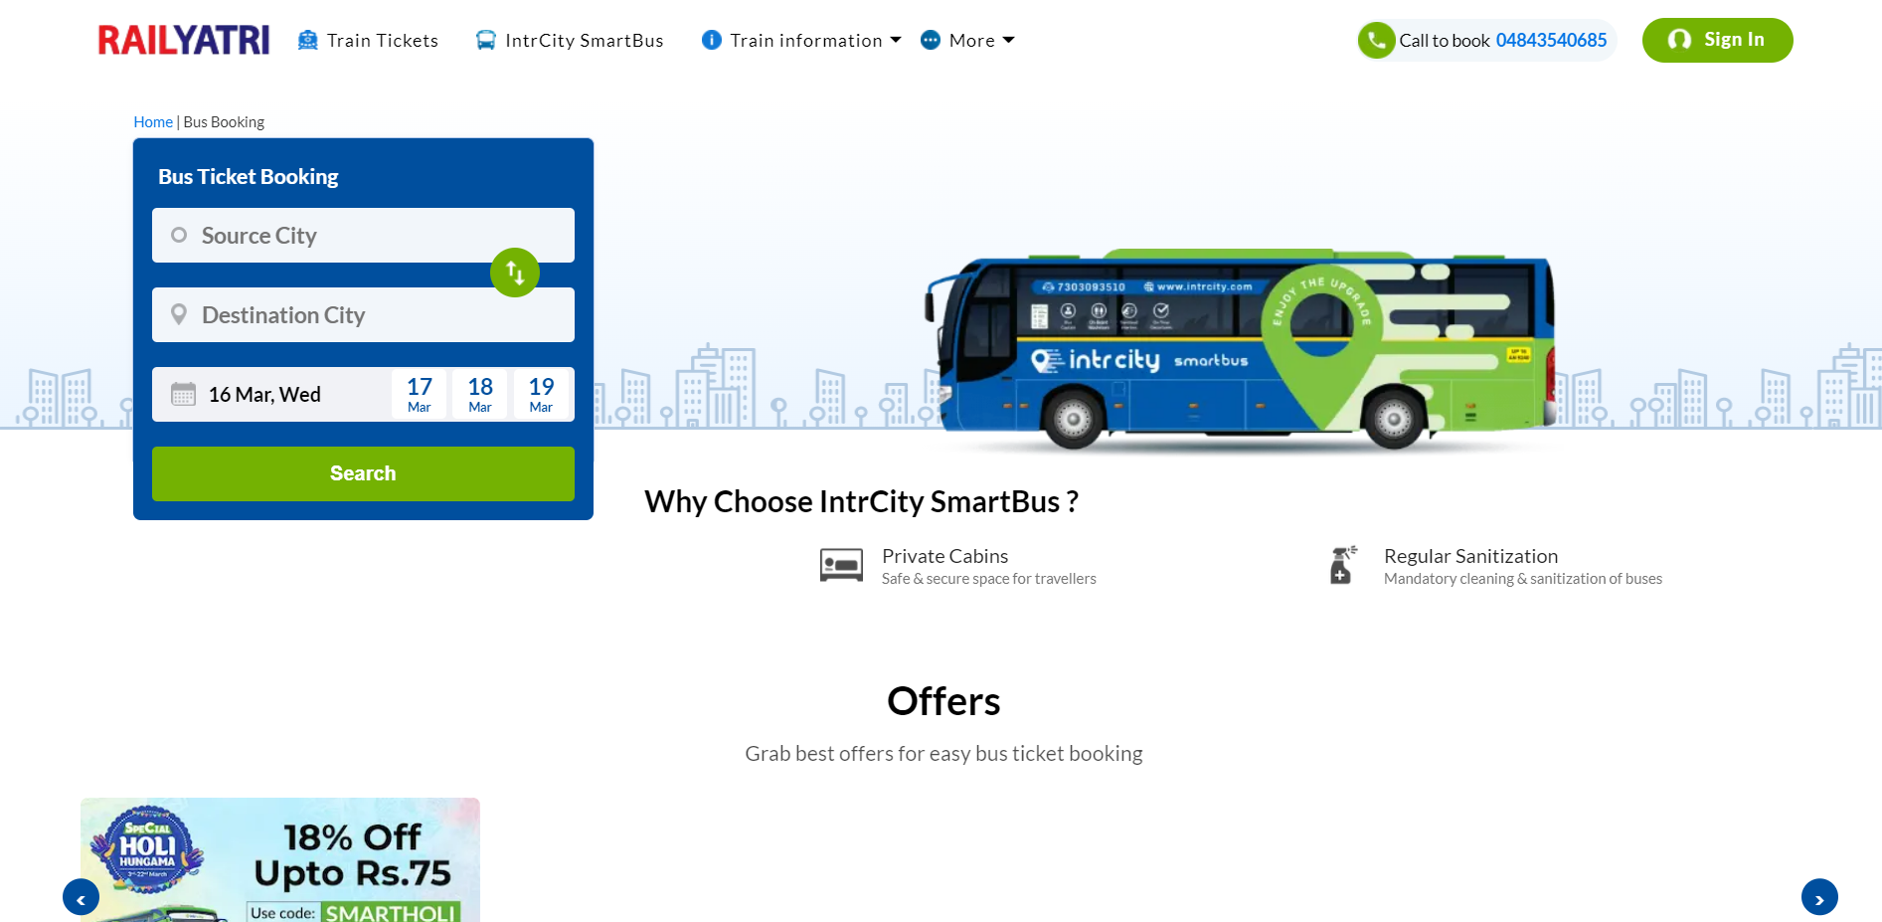
Project Screenshots – By Bus

Slide 20
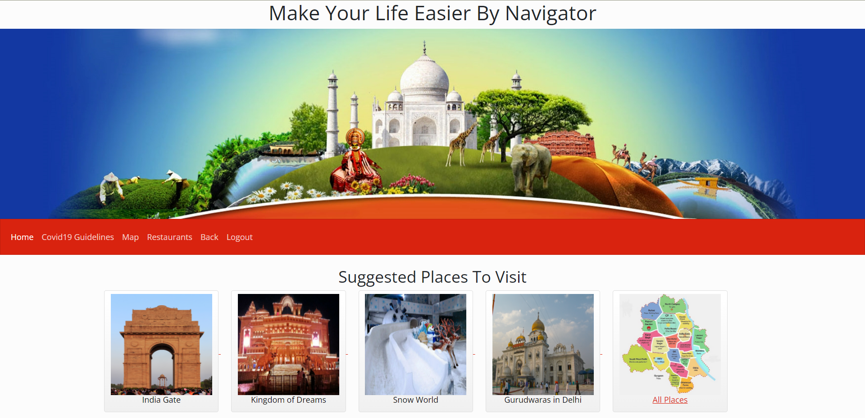
Project Screenshots – Suggested Places in Delhi

Slide 21
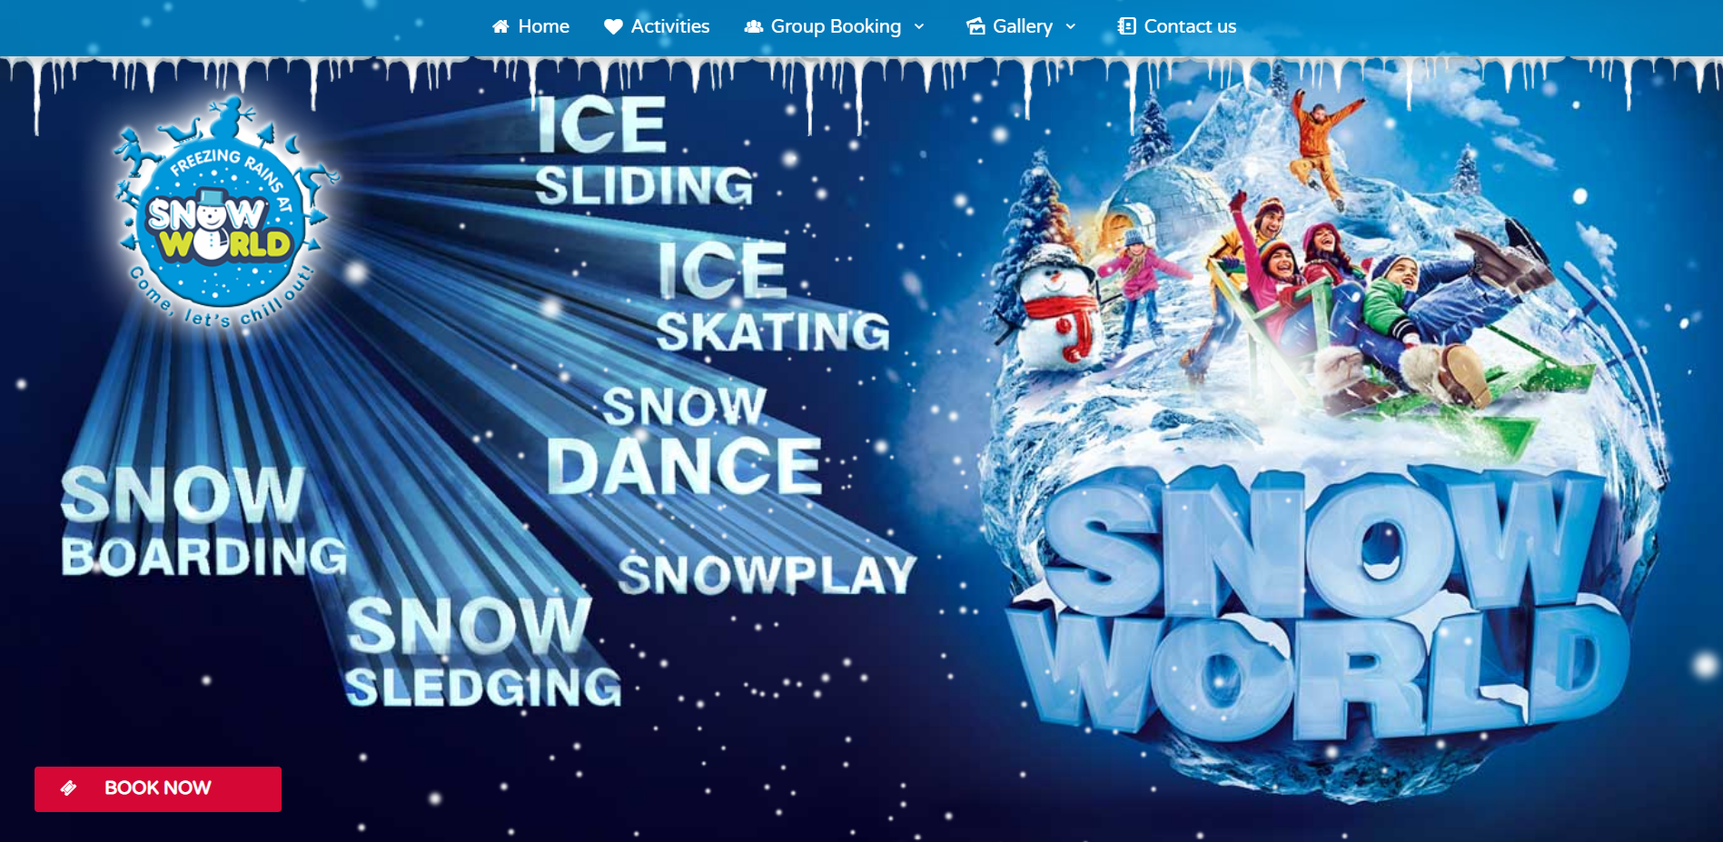
Project Screenshots

Slide 22
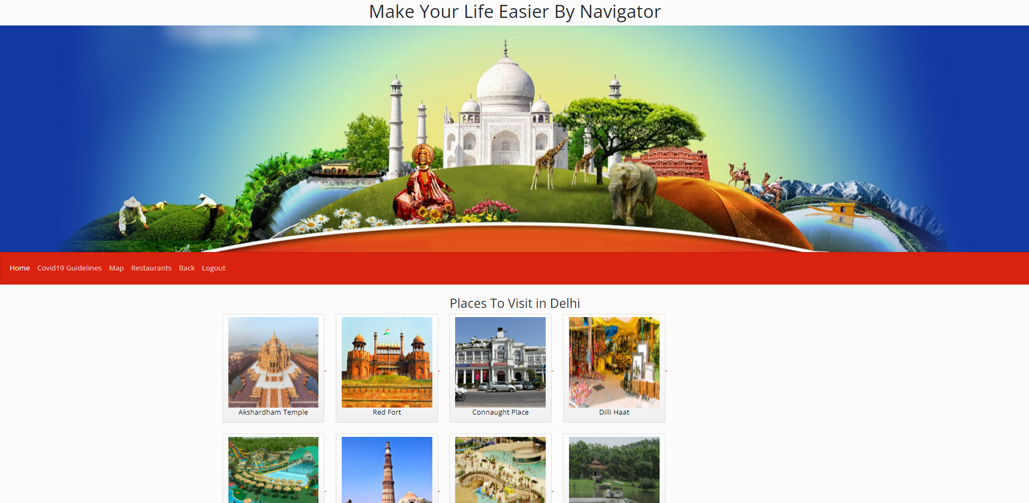
Project Screenshots – All Places

Slide 23
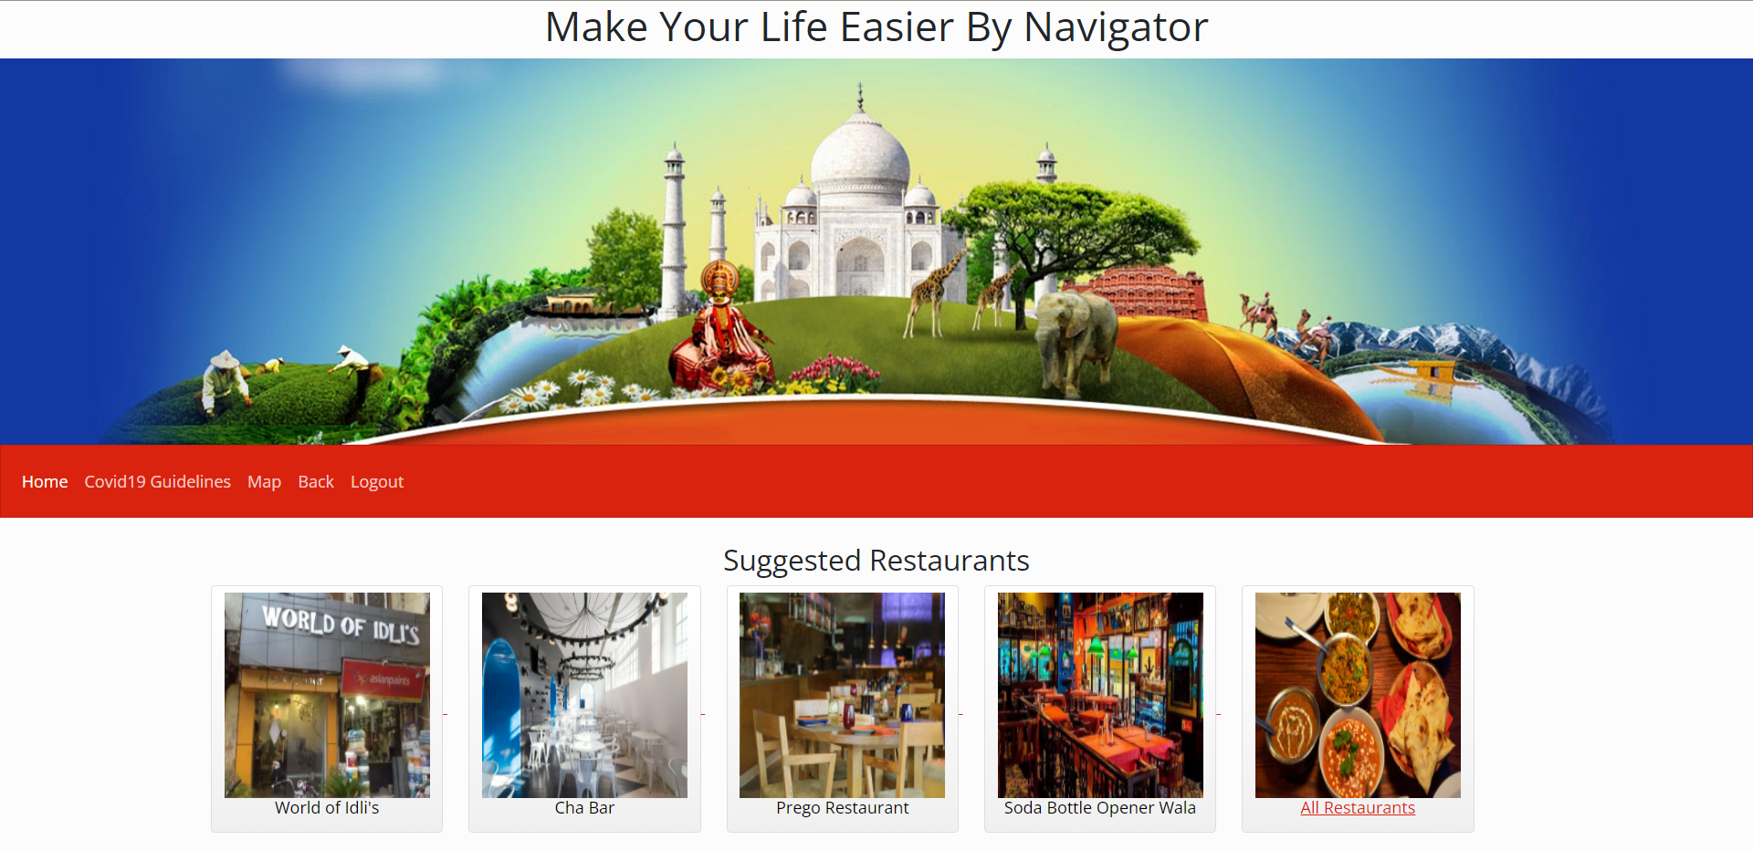
Project Screenshots – Suggested Restaurants

Slide 24
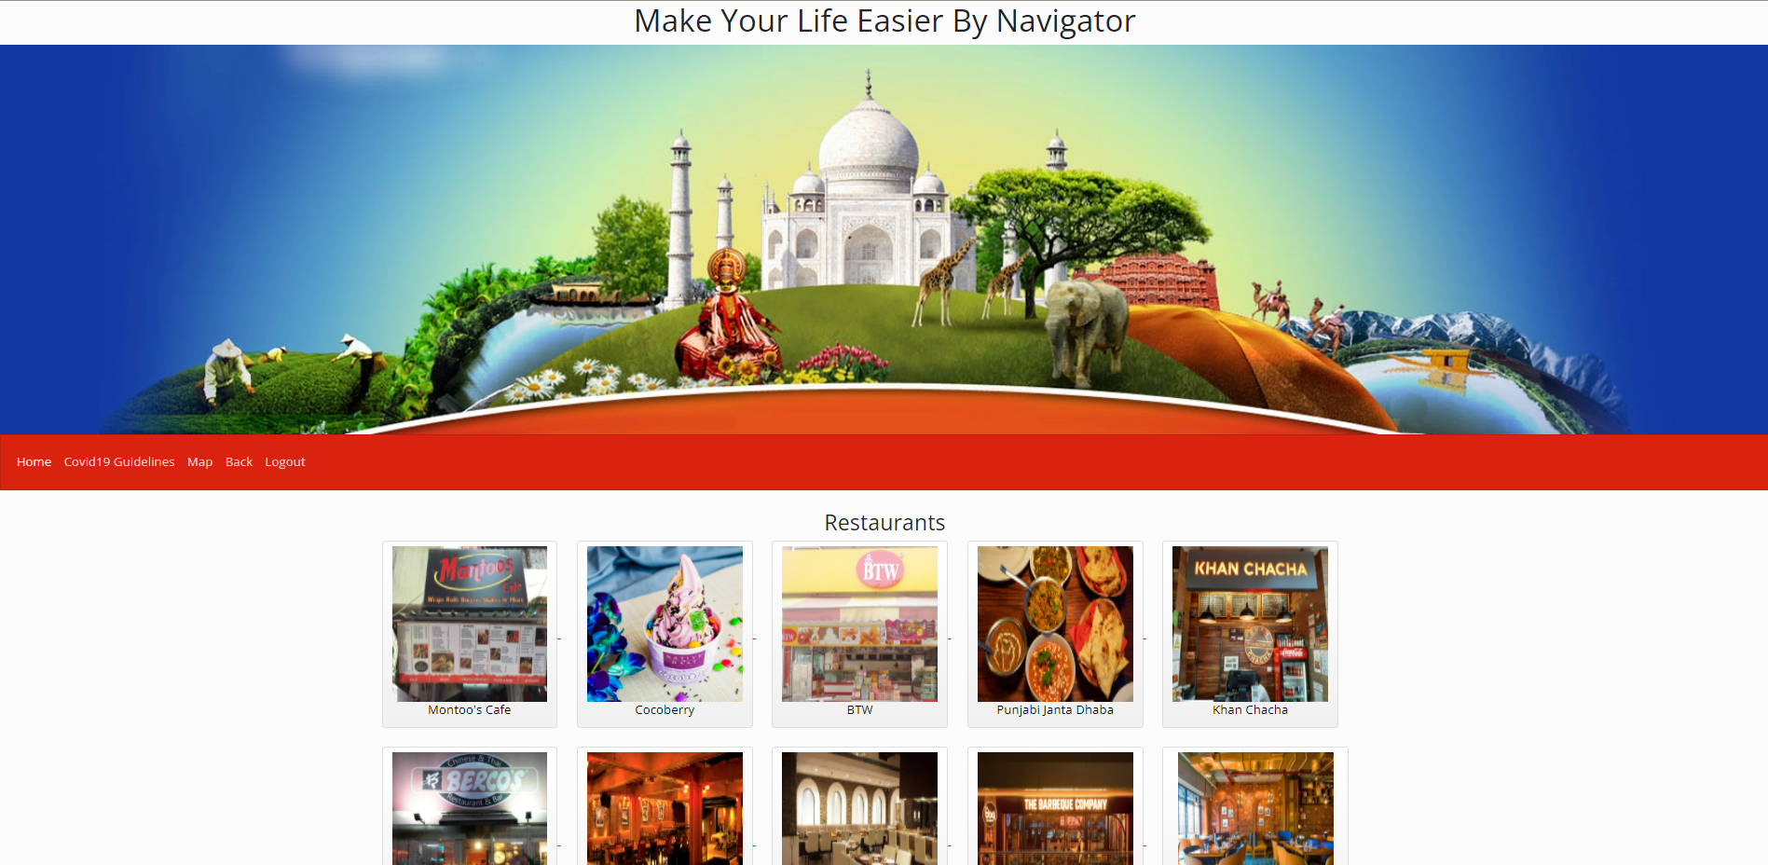
Project Screenshots – All Restaurants

Slide 25
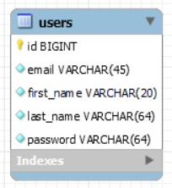
MySQL

Slide 26
Future Scope
Will Provide each and every detail of the tourist places in any state.
Will help people to travel hassle free.

Slide 27
References
How to Build City Guide App: Tech Stack, Costs and Great Examples (apiko.com)
https://www.google.com/travel/things-to-do/
https://www.tripadvisor.in/
https://bootswatch.com/5/simplex/bootstrap.min.css
https://youtu.be/aRLoSDOlU3w

Slide 28


